Slide 1

Healthy Food Policies in Los Angeles County Public Schools
Erica Halchak
UP 206A Final Presentation
3/15/2011
Notes:
http://blog.americanfeast.com/images/Vegetables,%20Healthy%20Food.jpg

Slide 2
Research Question
What schools in Los Angeles County would benefit most from healthy food policies?
Healthy policies are increasingly being focused on to help kids have healthy options when at school.

Slide 3

In December 2010, President Obama signed the Healthy, Hunger Free Kids Act, which includes health promoting food policies.
Includes items such as policies to help schools send messages about healthy eating (e.g., through vending machines) and piloting farm-to-school programs as well as promotion of organic foods.

Slide 4

Local Healthy Food Policies
The City of Los Angeles adopted a “Good Food for All Agenda”
Opportunities for Los Angeles County schools include:
  Local food purchasing policies
  (e.g., farmers markets)
  School gardens
  Healthy food retail in schools
Notes:
http://farm4.static.flickr.com/3446/3311844842_10fb448982.jpg

Slide 5
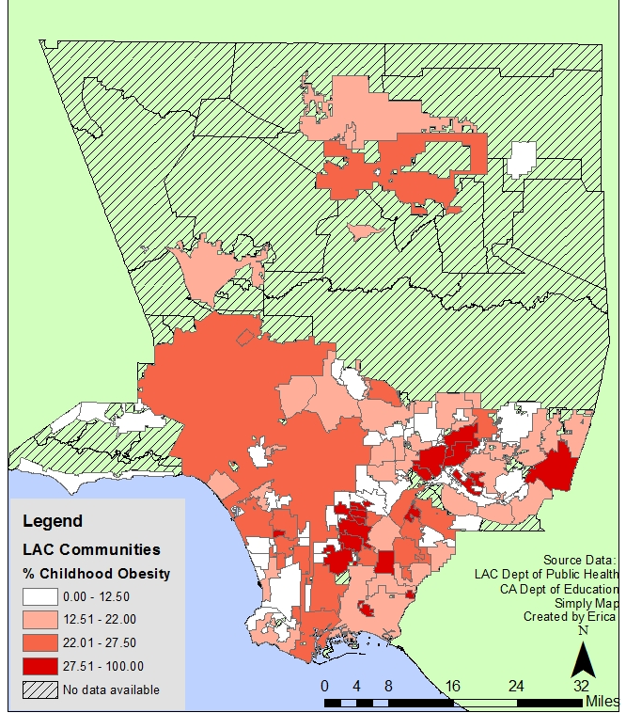
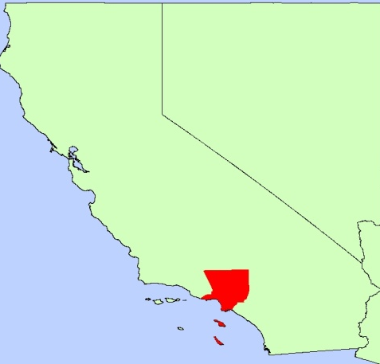
% Obesity in Los Angeles Communities
Almost 10 million people live in Los Angeles County
There are approximately 1.62 million public school students in Los Angeles County.
Obesity is increasingly a problem throughout Los Angeles County cities and communities.
Cities and communities have varying obesity rates, ranging from 3.5% in Manhattan Beach to 37. 3% in Irwindale.

Slide 6
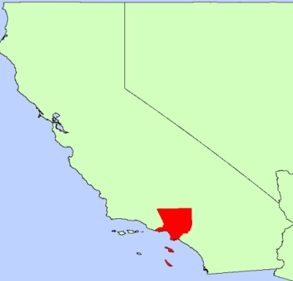
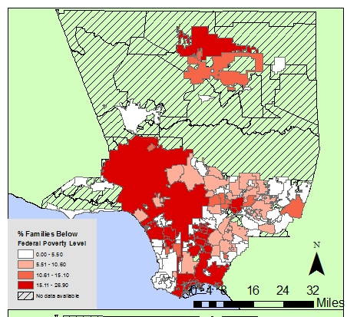

% Families Below the Federal Poverty Level in Los Angeles County
Total Number of Schools in Los Angeles County
Student Density in Los Angeles County
Source Data: US Census, CA Dept of Education, UCLA Simply Map
Created by Erica
Goal was to create an index to narrow down the communities in Los Angeles County to determine which had the highest need for healthy food policies.

Slide 7
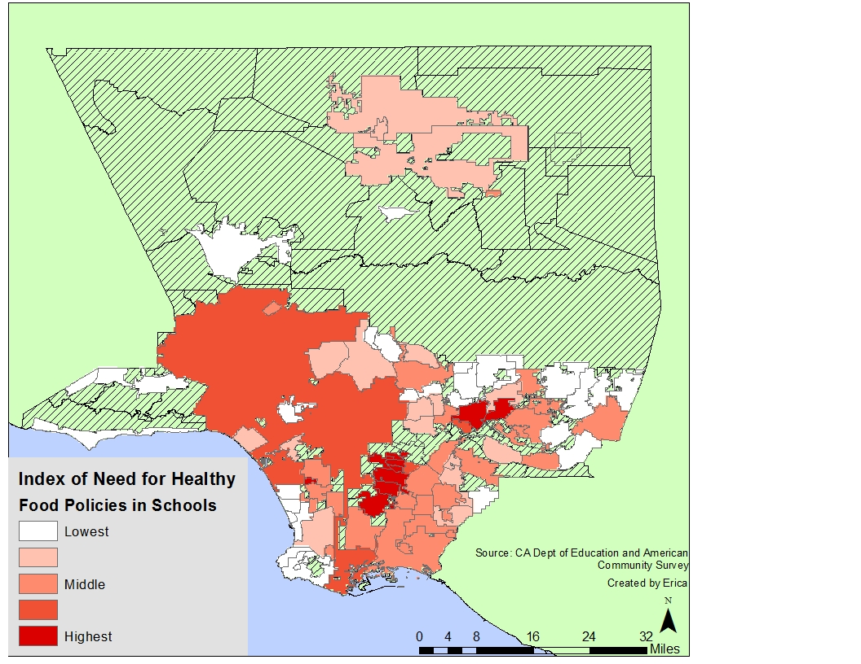
Index of Need for Communities in Los Angeles County
Created an index from the 4 aforementioned factors. The communities in red were chosen as ones with “highest need.”
The communities of highest need were clustered in certain areas, specifically South LA and East LA.

Slide 8
Index Calculations
The 4 included factors were ranked in order of importance.
Index of Need =
(4 * % Obesity in City) + (3 * Student Density ) + (2 * % of Families Below Poverty Level) + (Total Number of Schools in City )

Slide 9
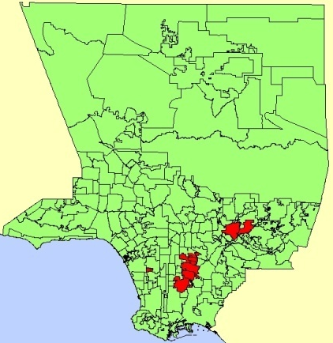
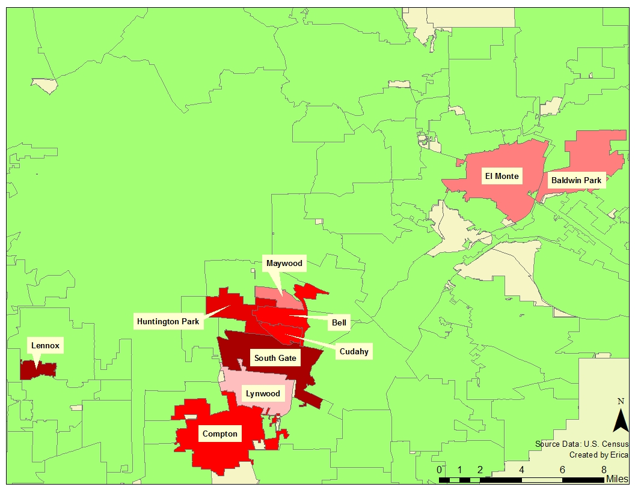
Communities Identified by Index of Need
City | Percent Obesity | Total Number of Students | Student Density | Percent Family Below Poverty | Total Number of Schools
Baldwin Park | 28.7 | 19366 | 3227.67 | 14.2 | 22
Bell | 29.0 | 7844 | 3922.00 | 20.1 | 5
Compton | 29.0 | 26435 | 2643.50 | 21.6 | 40
Cudahy | 29.2 | 6252 | 5582.14 | 21.8 | 4
El Monte | 28.3 | 24249 | 2694.33 | 18.3 | 32
Huntington Park | 30.3 | 18879 | 6293.00 | 22.1 | 17
Lennox | 31.4 | 6253 | 5684.55 | 26.9 | 7
Lynwood | 27.7 | 17034 | 4258.50 | 17.9 | 21
Maywood | 28.7 | 3750 | 3750.00 | 20.3 | 5
South Gate | 34.5 | 2787 | 3156.86 | 17.6 | 3

Slide 10
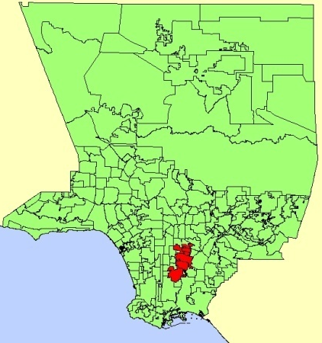
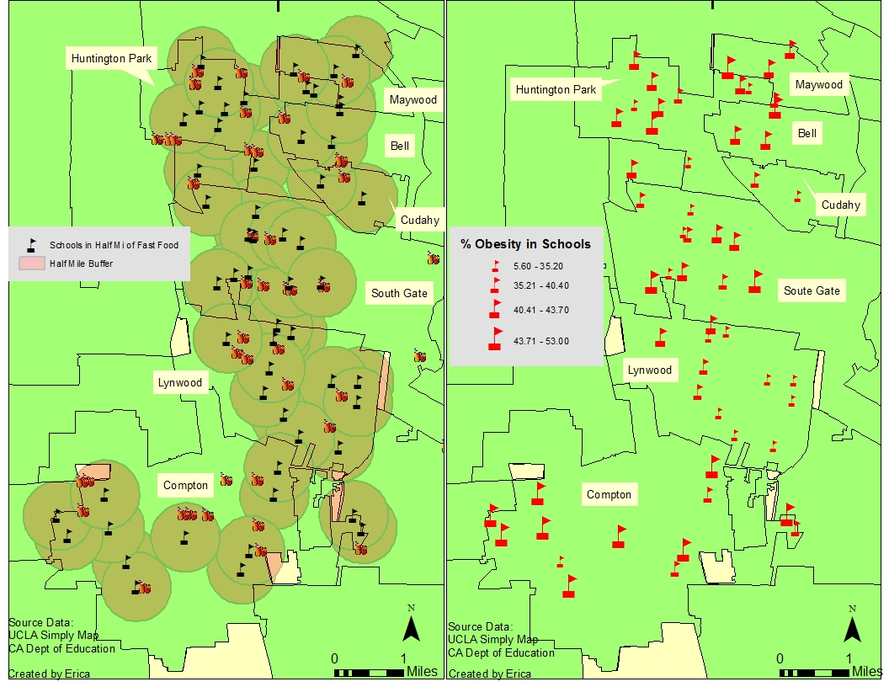
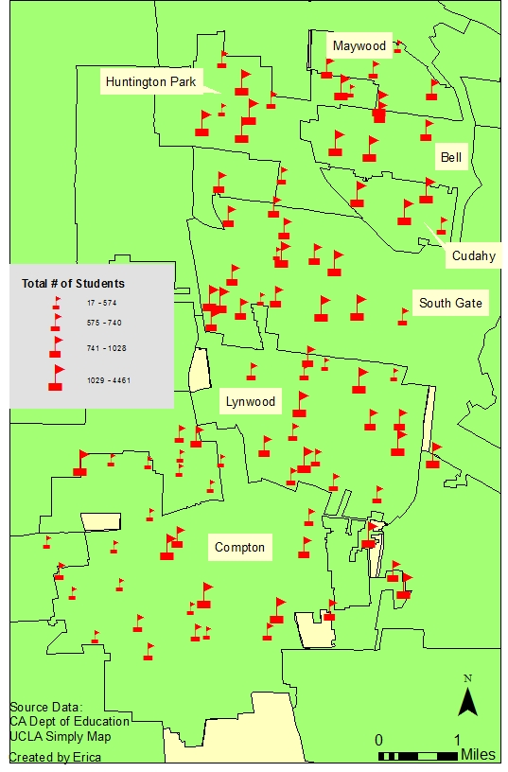
Example of factors used in creating the index to identify schools with the most need.
Schools within 0.5 Miles of Fast Food
% Obesity in Schools
Total # of Students in Schools

Slide 11
Index Calculation
To decide which schools had the most need, an index was created:
Index of Need =
(3* % Obesity in the School) + (2* Number of Fast Food Restaurants within .5 miles from the School) +(Total Number of Students in the School)

Slide 12

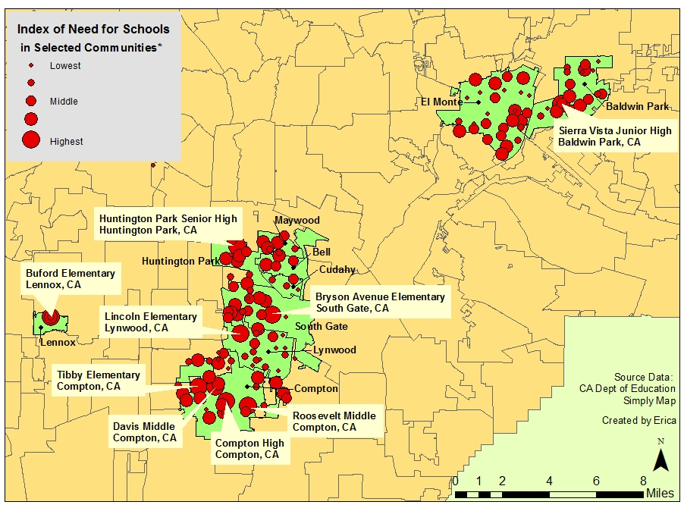
Schools Identified by Index of Need
* Named schools are ones identified by the created index

Slide 13

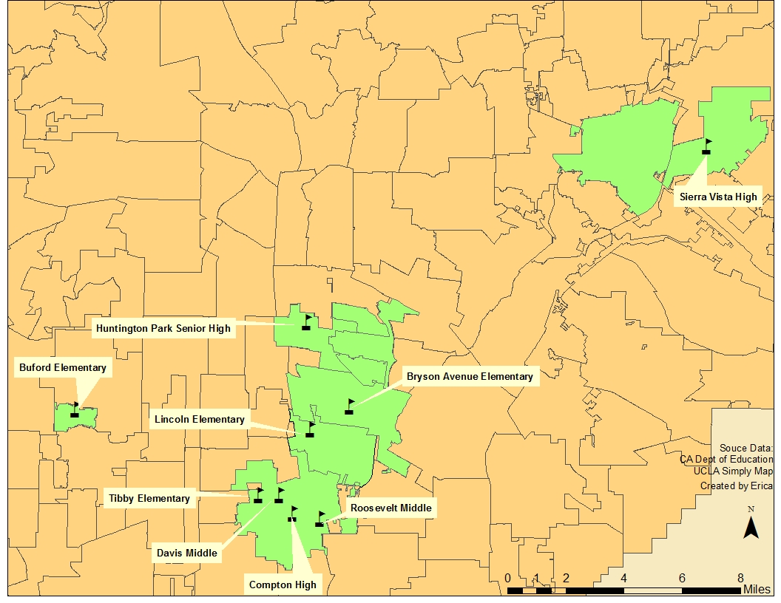


Identified Schools Data and Location
School | Street | City | # of Students | % Obesity | # Fast Food Restaurants in 0.5 miles
Davis Middle (6-8) | 621 West Poplar St. | Compton | 1327 | 48.9 | 1
Lincoln Elementary (KG-5) | 11031 State St. | Lynwood | 644 | 43.7 | 3
Buford Elementary (KG-5) | 10319 South Firmona Ave. | Lennox | 757 | 52 | 2
Huntington Park Senior High (9-12) | 6020 Miles Ave. | Huntington Park | 4251 | 42.8 | 2
Bryson Avenue Elementary (KG-5) | 4470 Missouri Ave. | South Gate | 1115 | 48.1 | 2
Roosevelt Middle (6-8) | 1200 East Alondra Blvd. | Compton | 1252 | 52.7 | 2
Tibby Elementary (KG-5) | 1400 West Poplar St. | Compton | 404 | 53.0 | 3
Sierra Vista High (9-12) | 3600 North Frazier St. | Baldwin Park | 2066 | 39.8 | 4
Compton High (9-12) | 601 South Acacia St. | Compton | 2530 | 44.3 | 3

Slide 14
Schools Identified
The schools identified via the index were determined to have the most need.
These schools stand to benefit from healthy food policies as obesity rates were above 39.8% and most had 2 or more fast food restaurants within 0.5 miles from the school.
Community gardens, healthy food in the vending machines, and purchasing local foods could help provide students with healthier food choices.

Slide 15
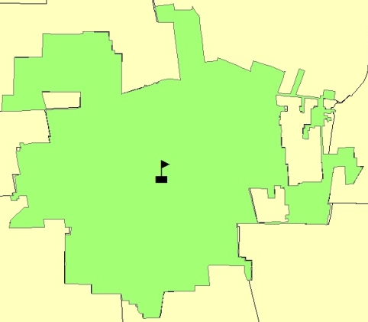
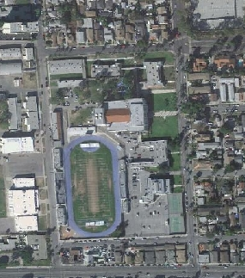
Compton High School
Compton High School:
-2530 students
-44.3% students overweight
-3 fast food restaurants are
within 0.5 miles for the school
May benefit from healthier food vendors at the school or serving locally purchased foods (e.g., from local farmers markets).

Slide 16
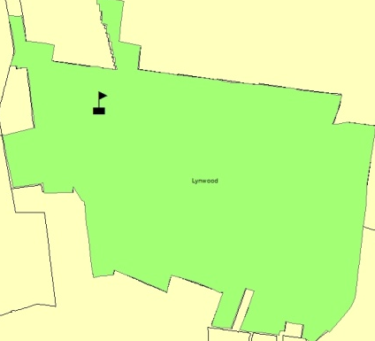
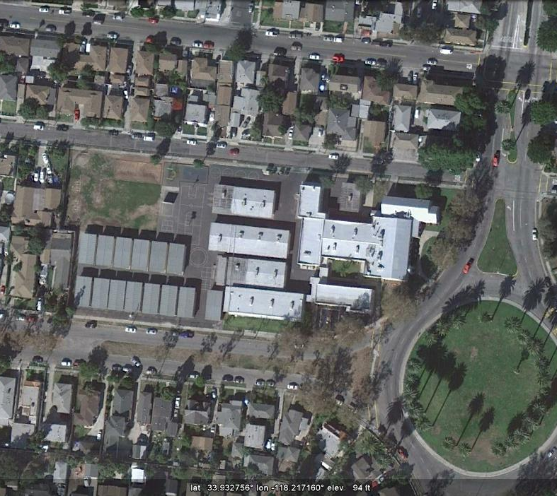
Lincoln Elementary School
Potential places for school garden
Lincoln Elementary School:
-644 students
-43.7 % students overweight
-3 fast food restaurants are
within 0.5 miles for the school
School gardens can provide locally grown healthy food for the school, teach children how to grow food, and create a sense of pride in the school and community.

Slide 17
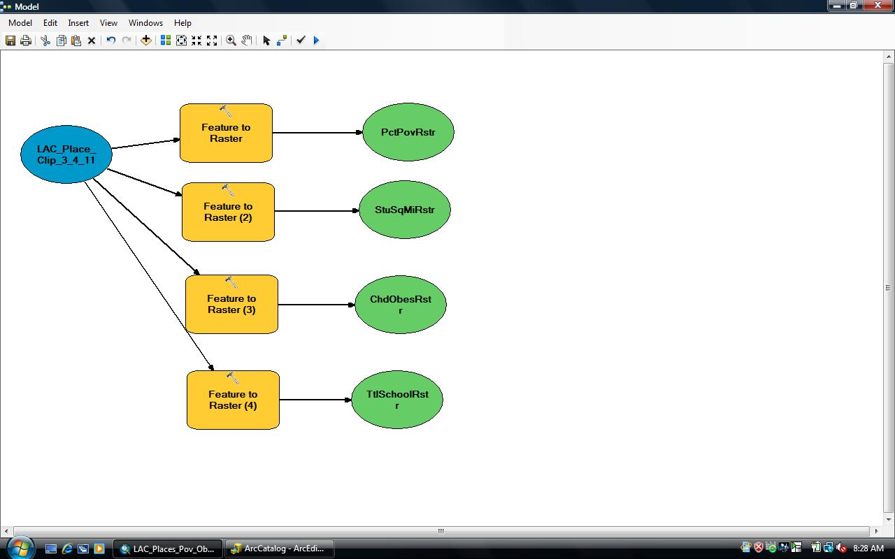

Slide 18
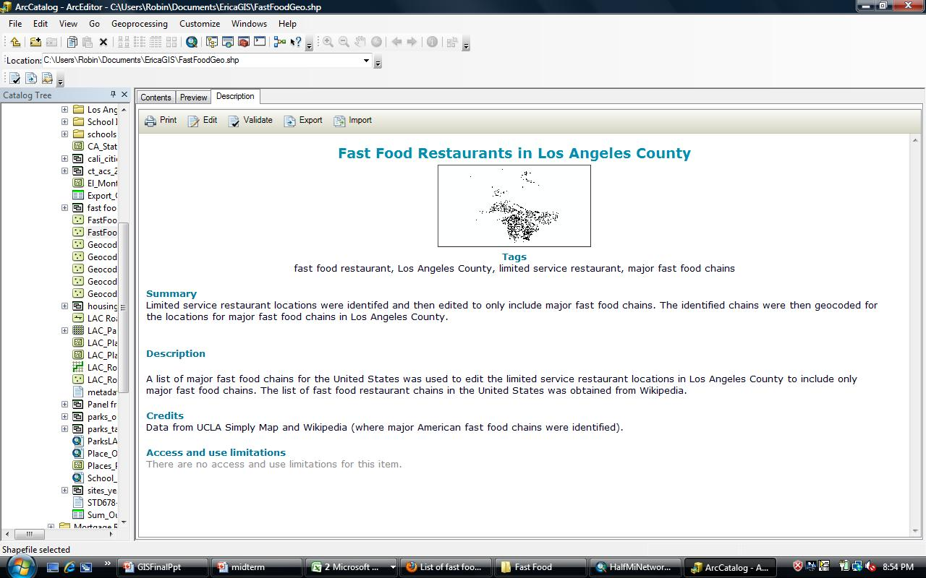

Slide 19
Skills Used
Modeling
  Created a model changing layers into rasters and then reclassified to create an index
Metadata
  Created a metadata file for the geocoded fast food restaurants
Measurement/Analysis
  Created half mile buffer around the schools located in the communities indentified by the index of need
Original data
  Schools, school obesity, poverty levels, and fast food restaurants were identified from UCLA Simply Map, CA Department of Education, and US Census
Spatial Analysis
  Raster index created
Charts
  Data for communities and schools indentified included in charts
Extracting information from a buffer
  Number of fast food restaurants were indentified as those lying with generated buffer

Slide 20
Skills Used
Inset map
  Los Angeles County and State of California
Graduated symbol
  Used to identify the schools that would benefit most from healthy food policies
Creating indices
  Created two indices, one to narrow down LAC communities to focus on and another to narrow down schools within those communities
Boundary sub-sets selection
  Created new shapfefiles for the 10 communities indentified by index
Geocoding
  Geocoded fast food restaurants and schools

